Slide 1

Greener Earth A Website On Climate Change
INFORMATION SYSTEM DESIGN AND SOFTWARE ENGINEERING LAB
Information Gathering and Interview
Samin Shahriar Tokey – 14.02.04.066 Naimul Haque – 14.02.04.080
Biozid Niloy – 14.02.04.070 Sanaul Miraj - 14.01.04.131
25-May-17

Slide 2
Objectives of Information Gathering and Interview
To identify the required contents for the users.
To find necessary scientific facts to convince people to believe Global Warming.
To gather information from other Websites dedicated to study Climate change.
To gather information about how everyone want to see Greener Earth website.
2

Slide 3
Questionnaires and Interview Pattern
Questions to Climate Science Expert.
Questions to the general people.
Face to face.
Diamond structured questions.
Close-ended questions.
Open-ended questions.
3

Slide 4
Selection of Interview Personnel
Dr. Maksud Kamal
Designation: Dean
Faculty of Earth and Environmental Sciences
Reason of selection :
He is an expert in Environmental Science.
He is also working on the Climate Science Research Bangladesh.
He knows Why Some Conservatives Can’t Accept That Climate Change Is Real
He can tell what kind of contents bring forth on our website to make people feel that climate change is a real threat.
4

Slide 5
Place of Survey
Universities of Dhaka City.
Online through Facebook.
Websites and pages of different global warming websites.
5

Slide 6
Participants of Survey
Students of AUST.
Friends and family of our Facebook .
6

Slide 7
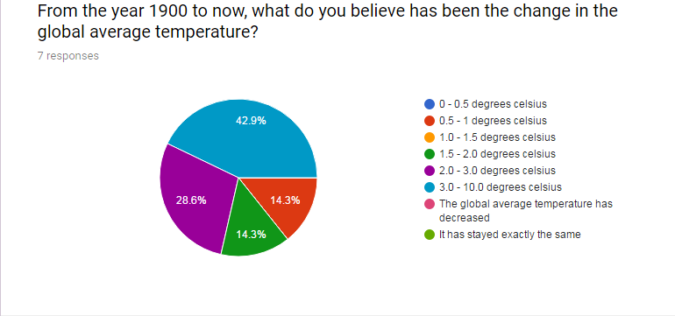
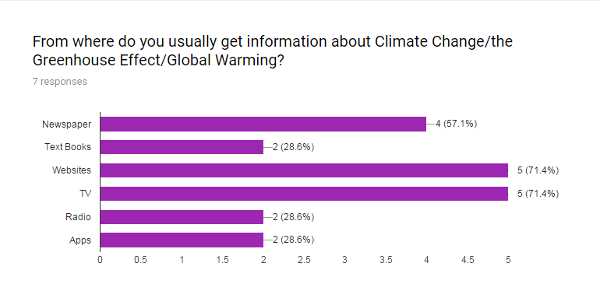
Questions and Answers of survey in form of Pie chart and bar diagram
25-May-17

Slide 8
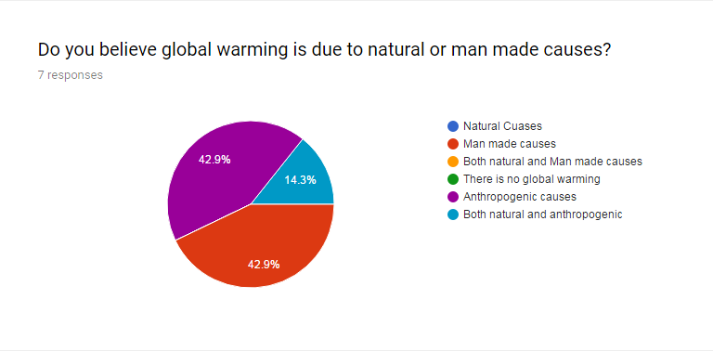
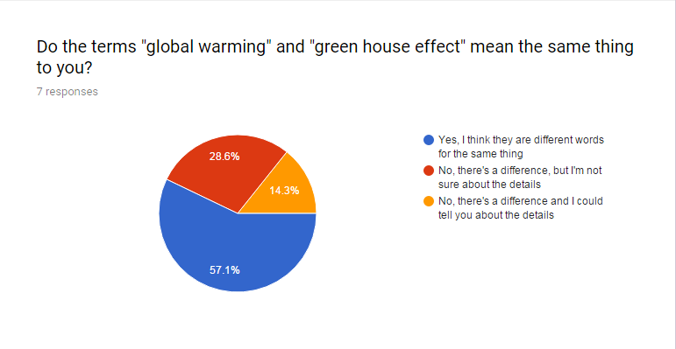
Questions and Answers of survey in form of Pie chart

Slide 9
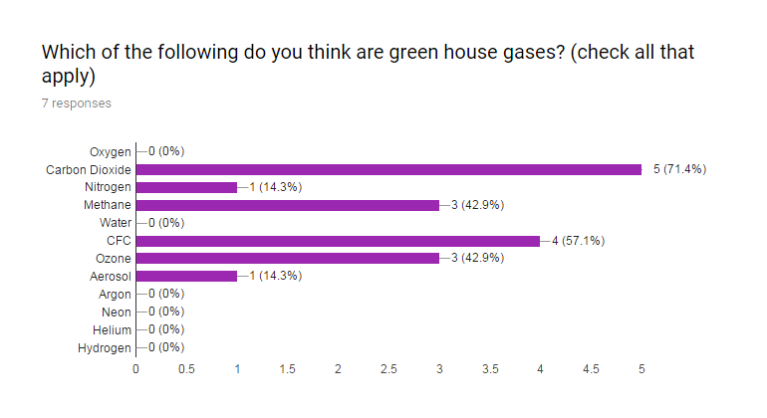
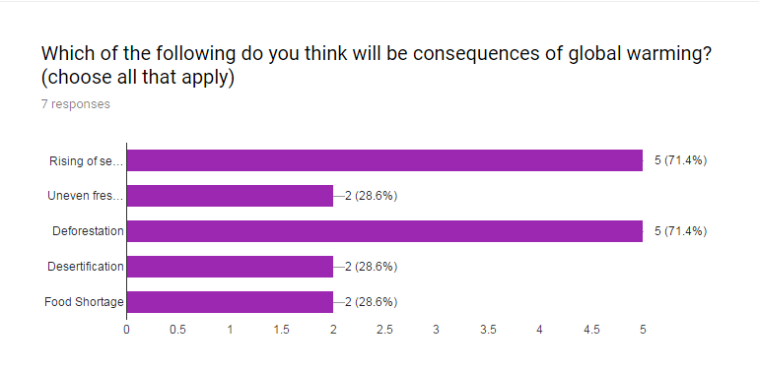
Questions and Answers of survey in form of bar diagram

Slide 10
Survey Analysis
42.9% of people people believe that global temperature have increased by 3.00 – 10.00 degree Celsius since 1990
71.4% people’s climate information source is websites
Only 42.9% of people thinks global warming is due to man made causes
57.1% people thinks “Global warming” and “Green house effect” is same.
57.1% people thinks that methane is not a Green house gas.
10

Slide 11
Survey Analysis
28.6% people think that Carbon dioxide is not a green house effect
28.8% people think that sea level will not rise due to Global warming
11

Slide 12
List of Activities
To design the website with sufficient visual contents to make people view Climate change as a threat.
To add scientific contents.
To Climate change records.
To add scientific blogs to distinguish between Global warming and Green house effects.
12

Slide 13
Conclusion
The interview and survey process gave us the opportunity to visit and interview different people and helped us a lot to know that people are really ignorant about the climate change. The website will be a fruitful project if we can reach out to the people , letting them know that the effects of global warming and climate is not just a theoretical concepts rather it’s already very practical in our country.
13
25-May-17

Slide 14

Thank you

